Slide 1
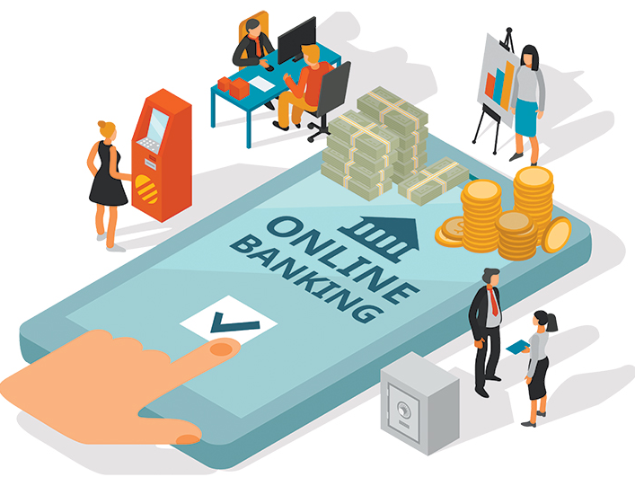
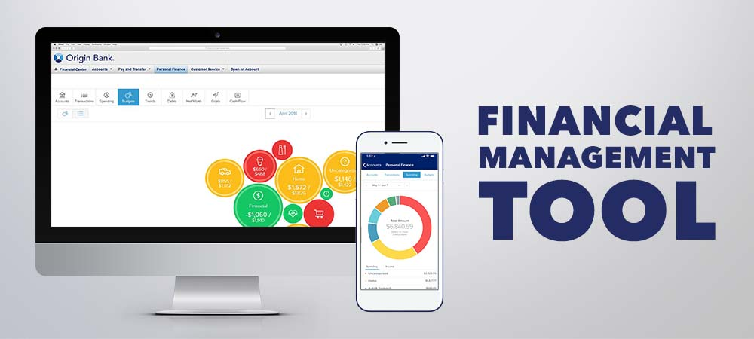
Online Banking & Financial Management Tools

Slide 2
Online banking, also known as internet banking, virtual banking, web banking or home banking, is a system that enables customers of a bank or other financial institution to conduct a range of financial transactions through the financial institution's website or mobile app. Since the early 2000s this has become the most common way that customers access their bank accounts.
What is Online Banking?

Slide 3
Key Feature of Online Banking
Online banking allows you to conduct financial transactions through a computer or smartphone using the internet.
With online banking, you don’t need to visit a branch to complete many transactions.
Many online banks offer lower fees and better rates than their brick-and-mortar competitors.
To take advantage of online banking, you’ll need an electronic device, an internet connection, and perhaps your debit card or account numbers.

Slide 4
History of Online Banking
Emergence in the late 20th century
Initial services like balance inquiry and fund transfers
Rapid growth in the 21st century
Advancements in technology and internet accessibility

Slide 5
How Online Banking Started
Evolution of banking services
Traditional brick-and-mortar branches to digital platforms
Introduction of online transactions
Convenience for customers and cost-effectiveness for banks

Slide 6
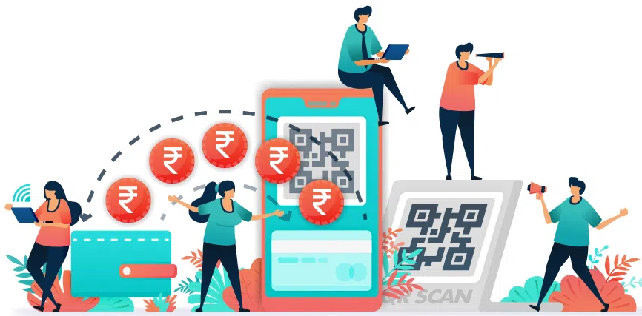
Online Transactions
Online Transaction Processing (OLTP) is information systems that facilitate and manage transaction-oriented applications, typically for data entry and retrieval transaction processing. So online transaction is done with the help of the internet. It can’t take place without a proper internet connection.

Slide 7
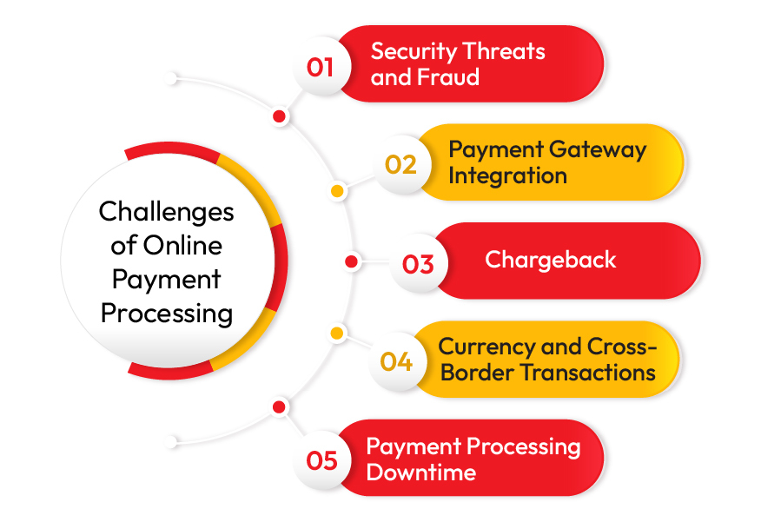
Challenges in Online Banking

Slide 8
Challenges in Online Banking
Security concerns - Risks of fraud and identity theft
Digital literacy - Ensuring customers understand and use online services effectively
Connectivity issues - Access to stable internet for seamless transactions

Slide 9
Benefits of Online Banking
Convenience - 24/7 access to account information and services
Cost-effectiveness - Reduced need for physical infrastructure and paperwork
Enhanced financial management - Real-time tracking of expenses and budgeting tools

Slide 10
Mobile Wallets and Contactless Payments
Integration with mobile wallets - Facilitating quick and secure transactions
Contactless payment options - Enhancing the speed and efficiency of transactions

Slide 11
Regulatory Framework
Rules by Government - Laws ensuring online transactions are safe and private.
Global Standards - Following worldwide financial rules to keep transactions secure.

Slide 12
Impact of COVID-19
More Online Use - People relying more on online banking during lockdowns.
Safe Transactions - Growing preference for touchless payments for safety.

Slide 13
Accessibility Challenges
Everywhere Access - Making sure even rural areas can use online banking.
Digital Equality - Trying to close the gap between those who can and can't access online services.

Slide 14
Integration of Biometric Authentication
Fingerprints and Faces - Using unique physical features for secure logins.
Easy and Safe - Making sure it's simple for users while keeping accounts safe.

Slide 15
Future of Online Banking
Technological advancements - Integration of artificial intelligence and block chain.
Expansion of services - More sophisticated financial planning tools, virtual banking assistants

Slide 16


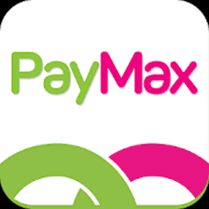

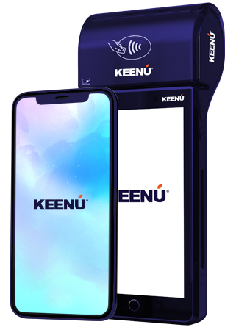
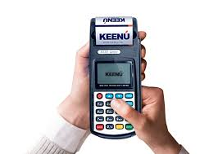
Commonly Used Online Financial Management Tools
JazzCash
Easypaisa
Zong PayMax
1LINK and MNET
Keenu Wallet, etc.

Slide 17
JazzCash
JazzCash is a mobile financial service provided by Jazz, one of the leading telecommunications companies in Pakistan.
It allows users to perform various financial transactions, including sending and receiving money, paying bills, and buying mobile load.
JazzCash aims to provide convenient and secure financial services, especially for those who may not have easy access to traditional banking.

Slide 18
Easypaisa
Easypaisa is another popular mobile wallet service in Pakistan, operated by Telenor, a major telecom operator in the country.
Similar to JazzCash, Easypaisa enables users to conduct financial transactions, pay bills, and perform mobile top-ups.
It also includes services such as international remittances and mobile account services.

Slide 19
Zong PayMax
Zong PayMax is a digital payment solution offered by Zong, a telecommunications company in Pakistan.
This service allows users to make payments for various products and services using their mobile phones.
Zong PayMax aims to enhance the convenience of digital transactions for its users.

Slide 20
1LINK and MNET
1LINK is a consortium of major banks in Pakistan that operates an interbank electronic funds transfer (EFT) switch.
MNET, or MCB Arif Habib Mutual Fund Network, is a mutual fund online transaction platform.
Together, these networks facilitate secure and efficient electronic transactions, including ATM withdrawals, online payments, and interbank fund transfers.

Slide 21
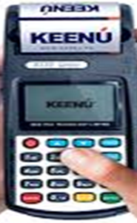
Keenu Wallet
Keenu Wallet is a mobile wallet and digital payment solution in Pakistan.
Users can link their bank accounts or credit/debit cards to the Keenu Wallet for making seamless transactions.
It supports various features such as bill payments, online shopping, and peer-to-peer transfers

